Slide 1
DEPLETION OF BIO-DIVERSITY
Main Causes of Depletion of Biodiversity in Dhaka
Unplanned Urbanization
Habitat Destruction and Land Filling
Severe Water Pollution
Air Pollution
Deforestation and Tree Cutting
Encroachment and Illegal Occupation
Overpopulation and High Population Density
Industrial Expansion
Use of Pesticides and Chemicals
Industrial Expansion

Slide 2
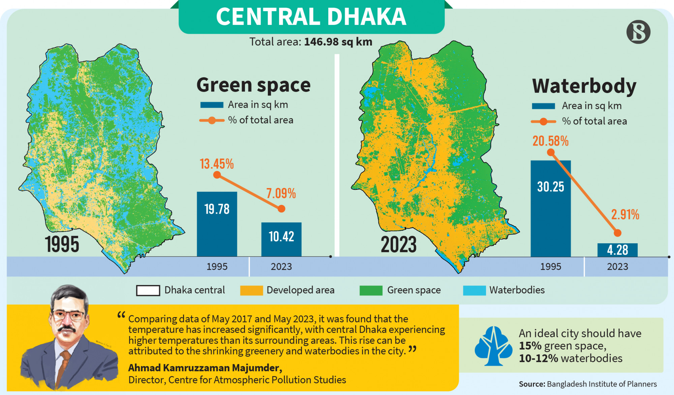
https://www.tbsnews.net/bangladesh/dhaka-green-spaces-shrink-7-wetlands-now-mere-3-bip-643082
Chobi ai source theke neya

